Slide 1
R
Data Frames

Slide 2
A data frame is a table or a two-dimensional array-like structure.
Row – Column Type
x <- data.frame()
Inform Here using – Editors
Rstudio + Notepad++
PyCharm

Slide 3
source("C:/Users/radha/Desktop/Rtest/dataFrame.r") on Rstudio

Slide 4
Column Names – id, name etc.
# Create the data frame.
emp.data <- data.frame(
emp_id = c (1001,1002,1003,1004,1005),
emp_name = c("Sachin","Dhoni", "ganguly", "Kohli","rohit"),
salary = c(623333,815543,611314,929441,843215),
start_date = as.Date(c("2012-01-01", "2013-09-23", "2014-11-15", "2014-05-11",
"2015-03-27")),
stringsAsFactors = FALSE
)
# Print the data frame.
print(emp.data)

Slide 5
# Get the structure of the data frame. str(emp.data)
stringsAsFactors = TRUE
print(summary(emp.data))
# Extract Specific columns.
result <- data.frame(emp.data$emp_name,emp.data$salary) print(result)
# Extract first two rows.
result <- emp.data[1:2,]
print(result)

Slide 6
Add column/Rows
A data frame can be expanded by adding columns and row
$dept – new column, in this each one represents, corresponding row in that columns !!
emp.data$dept <- c("IT","Operations","IT","HR","Finance")
# Add the "dept" coulmn.
emp.data$dept <- c("IT","Operations","IT","HR","Finance") v <- emp.data
print(v)

Slide 7
Row
Add Row
rbind() function.
Merge 2 data frames. Both must have Equal column size and order.
# Bind the two data frames.
emp.finaldata <- rbind(emp.data, emp.newdata)
print(emp.finaldata)

Slide 8
> n = c(2, 3, 5) > s = c("aa", "bb", "cc") > b = c(TRUE, FALSE, TRUE) > df = data.frame(n, s, b) # df is a data frame
mtcars _ Example, Default with R
The top line of the table, called the header, contains the column names. Each horizontal line afterward denotes a data row, which begins with the name of the row, and then followed by the actual data. Each data member of a row is called a cell.

Slide 9
mtcars[1, 2]
Row, Column – Order []
mtcars["Mazda RX4", "cyl"]
nrow(mtcars)
ncol(mtcars)
head(mtcars)
head(mtcars,10)

Slide 10
Column Vector
Get data from DF –
[[ ]]
mtcars[[9]]
mtcars[["am"]]
mtcars$am
mtcars[,"am"]

Slide 11
Column Slice
mtcars[1]
mtcars["mpg"]
mtcars[c("mpg", "hp")]
Observe diff :
Mtcars[[1]] and mtcars[1] ( single and double brackets )

Slide 12
mtcars[c(3, 24),]
mtcars["Camaro Z28",]
Logical indexing
L = mtcars$am == 0
mtcars[L,]

Slide 13
From Files ( csv , xml) you will get data frame, or you can convert into data frame for further modification in data.
# Or just retrieve the names with the `names()` function
names(mtcars)
[1] "mpg" "cyl" "disp" "hp" "drat" "wt" "qsec" "vs" "am" "gear" "carb“
Rename it
> names(mtcars) <- c("A","B","C","D","E","F","G","H","I","J","K")
> mtcars

Slide 14
colnames(writers_df)
rownames(writers_df)
dim()
> dim(mtcars) [1] 32 11
32 Rows, 11 columns
Nrows()
Ncols()
length() – No of columns

Slide 15
# Access the values
writers_df$Age.As.Writer
# Try to change the values
Age.As.Writer[1] <- 2

Slide 16
attach()
Instead of typing every time “$” for column access
# Look up the search path
search()# Attach the `writers_df`
attach(writers_df)
# Alternatively, use `with()` to attach `writers_df`
with(writers_df, c("Age.At.Death", "Age.As.Writer", "Name", "Surname", "Gender", "Death"))

Slide 17
apply()
# Apply the median to `Ages`
apply(Ages, 2, median)
Data Frame, column Name, Function – Order
apply(mtcars,1,sum)
apply(mtcars,2,sum)

Slide 18
you can use the stack() function or you can try using the reshape() function.
The stack() function basically concatenates or combines multiple vectors into a single vector, along with a factor that indicates where each observation originates from.

Slide 19
In this case, you want to merge the columns Read, Write and Listen together,
# Construct the long format
long_format <- stack( observations_wide,
select=c(Read,
Write,
Listen))
# Construct the wide format
wide_format <- unstack(observations_long, Result ~ Test)

Slide 20
reshape()
This function is part of the stats package. This function is similar to the stack() function, but is a little bit more elaborate.
# Import `reshape2`
library(reshape2)
# Convert to a wide format with `dcast()`
long_reshaped2 <- dcast(observations_long,
Subject + Gender ~ Test,
value.var="Result")
# Return `long_reshaped2`
long_reshaped2

Slide 21
# Reshape to wide format
wide_reshape <- reshape(observations_long,
timevar = "Test",
idvar = c("Subject", "Gender"),
direction = "wide")
# Return `wide_reshape`
wide_reshape

Slide 22
tidyr
spread() and gather()
melt()
library(reshape2)

Slide 23
# Use `order()` to order
writers_df[order(Name, decreasing=TRUE),]
# Use `rev()` to order
writers_df[rev(order(Name)),]
# Order on numeric variable
writers_df[order(-Age.As.Writer),]

Slide 24
dplyr package
arrange()
data2 <- arrange(writers_df, Age.At.Death, Age.As.Writer)
desc_sorted_data <- arrange(writers_df, desc(Age.At.Death))

Slide 25
Merging Data Frames On Column Names
merge()
To remove all rows that contain NA-values, one of the easiest options is to use the na.omit()function, which takes your data frame as an argument.

Slide 26
reshape2
Wide data (Wide data has a column for each variable. )
long-format data (No id variables; using all as measure variables)
Long-format data has a column for possible variable types and a column for the values of those variables.
Airquality
> airquality
Ozone Solar.R Wind Temp Month Day
1 41 190 7.4 67 5 1
2 36 118 8.0 72 5 2
3 12 149 12.6 74 5 3
4 18 313 11.5 62 5 4
5 NA NA 14.3 56 5 5

Slide 27
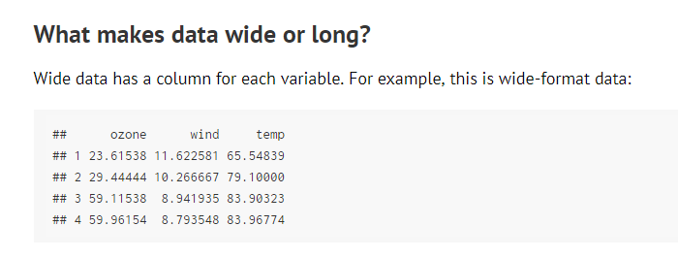

Slide 28
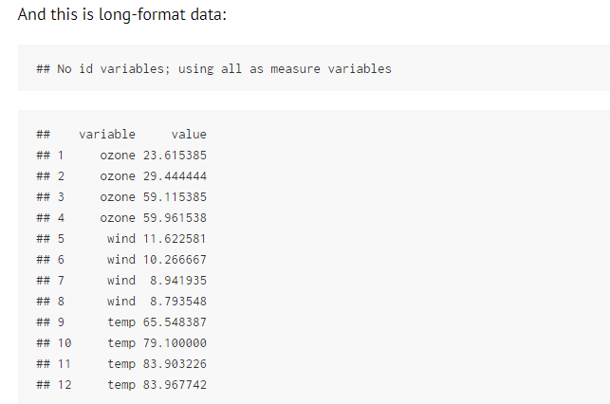

Slide 29
reshape2 is based around two key functions: melt and cast:
melt takes wide-format data and melts it into long-format data.
cast takes long-format data and casts it into wide-format data.

Slide 30
airquality
names(airquality) <- tolower(names(airquality))
aql <- melt(airquality)
## No id variables; using all as measure variables ??
head(aql)
tail(aql)
aql <- melt(airquality, id.vars = c("month", "day"))
head(aql)
ID variables are the variables that identify individual rows of data.

Slide 31
aql <- melt(airquality, id.vars = c("month", "day"),
variable.name = "climate_variable",
value.name = "climate_value")

Slide 32
the cast functions
Long- to wide-format data
> aql <- melt(airquality, id.vars = c("month", "day"))
> aqw <- dcast(aql, month + day ~ variable)
> head(aqw)

Slide 33
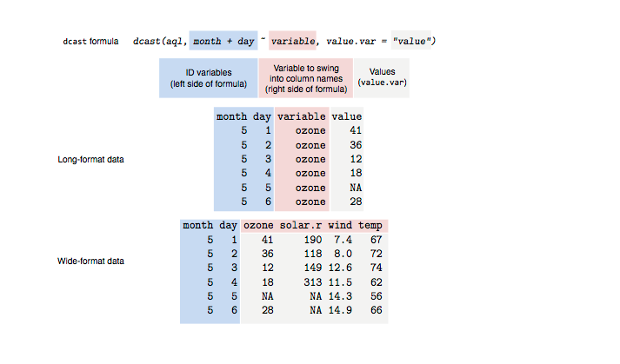

Slide 34
Aggregate
values <- data.frame(value = c("a", "a", "a", "a", "a",
"b", "b", "b",
"c", "c", "c", "c"))
nr.of.appearances <- aggregate(x = values,
by = list(unique.values = values$value),
FUN = length)
aggdata <-aggregate(mtcars, by=list(cyl,gear), FUN=mean, na.rm=TRUE)

Slide 35
> attach(airquality)
> aggdata <-aggregate(airquality, by=list(ozone,temp), FUN=mean, na.rm=TRUE)
>
> aggdata
aggdata <-aggregate(mtcars, by=list(cyl,gear), FUN=mean, na.rm=TRUE)
by=list(Group.cyl=cyl, Group.gears=gear).

Slide 36
transpose
transpose (reversing rows and columns)
t(cars)

